Slide 1
SegNet
Presenter: Khakim Akhunov
22.10.2019, NTNU

Slide 2
SegNet: A Deep Convolutional Encoder-Decoder Architecture for Image Segmentation
Vijay Badrinarayanan, Alex Kendall, Roberto Cipolla, Senior Member, IEEE
10 Oct 2016

Slide 3
What Semantic Segmentation is?
The process of assigning a label to every pixel in the image.
Semantic segmentation treats multiple objects of the same class as a single entity.

Slide 4
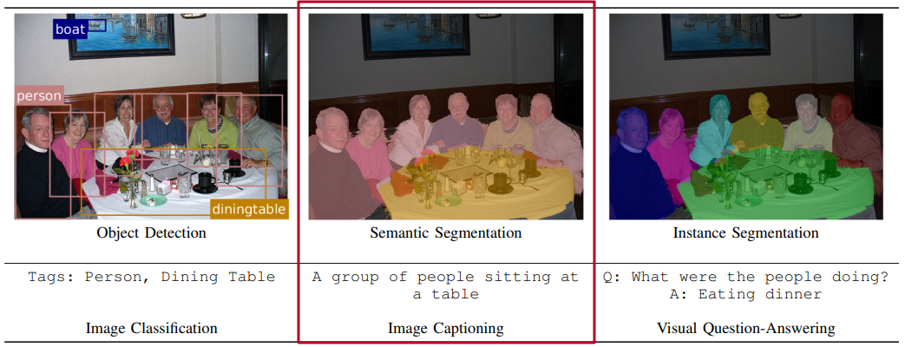
Example of various Scene Understanding tasks
Source: http://www.robots.ox.ac.uk/~tvg/publications/2017/CRFMeetCNN4SemanticSegmentation.pdf
Notes:
Some tasks, such as image classification, provide a high-level description of the image by classifying whether certain tags exist. Other tasks like object detection, semantic segmentation and instance segmentation provide more detailed and localised information about the scene.

Slide 5
What SegNet is?
Novel and practical deep fully convolutional neural network architecture for semantic pixel-wise segmentation.
SegNet = (Encoder + Decoder) + Pixel-Wise Classification layer
It is primarily motivated by road scene understanding applications which require the ability to model appearance (road, building), shape (cars, pedestrians) and understand the spatial-relationship (context) between different classes such as road and side-walk.

Slide 6
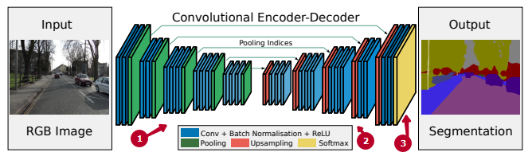
SegNet architecture
1 - encoder network
2 - decoder network
3 - pixel-wise classification layer

Slide 7
Main motivations behind SegNet
Retain boundary information in the extracted image representation
Efficient in terms of both memory and computation time
Able to train end-to-end using efficient weight update technique

Slide 8
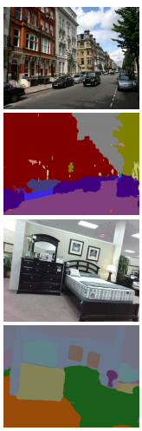
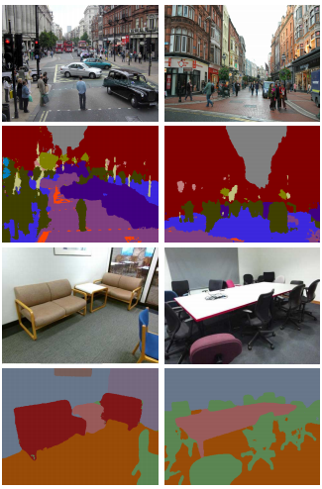
SegNet predictions on road scenes and indoor scenes

Slide 9
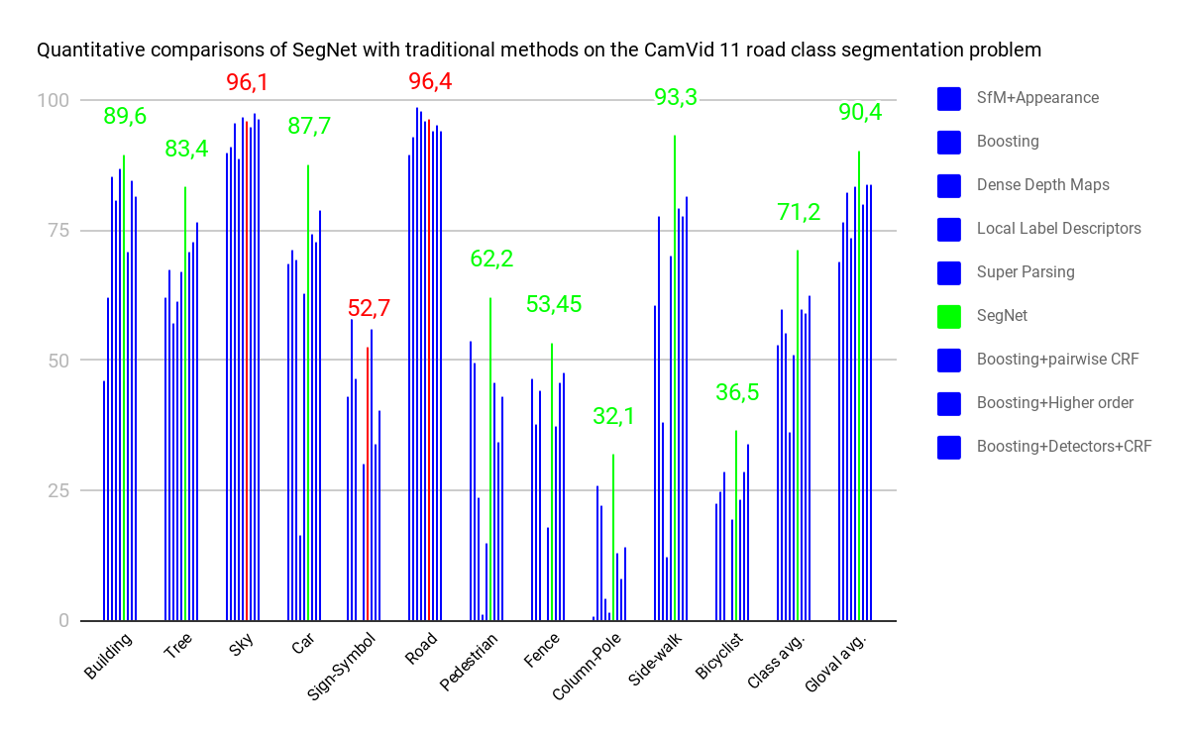

Slide 10


Encoding
Decoding

Slide 11
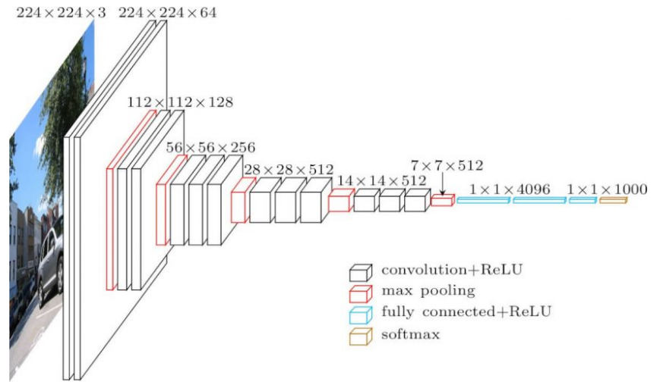
VGG16 architecture

Slide 12
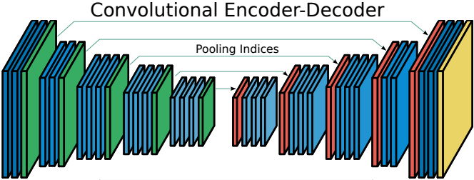
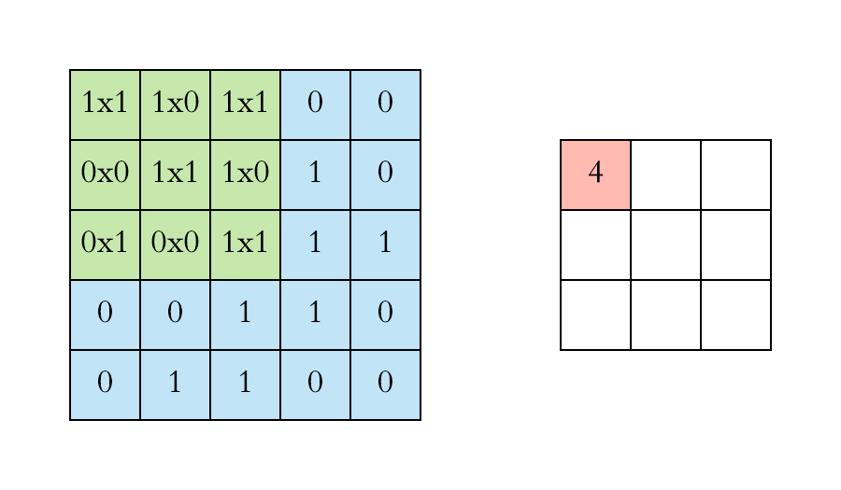
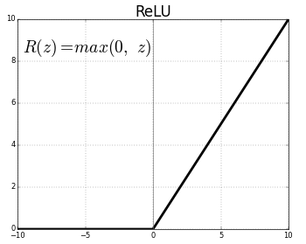
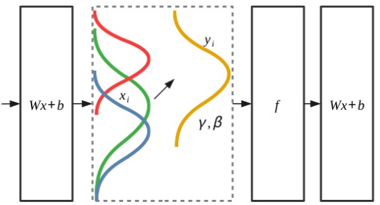
3x3conv
Batch Normalization
ReLU

Slide 13
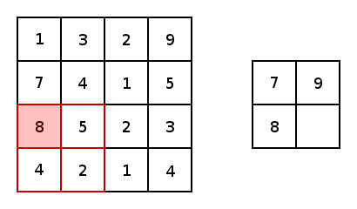
2x2 Max-pooling
Notes:
Is used to achieve translation invariance over small spatial shifts in the input image.

Slide 14
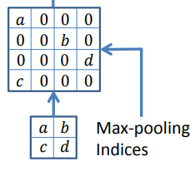
Upsampling
Notes:
Is used to achieve translation invariance over small spatial shifts in the input image.

Slide 15
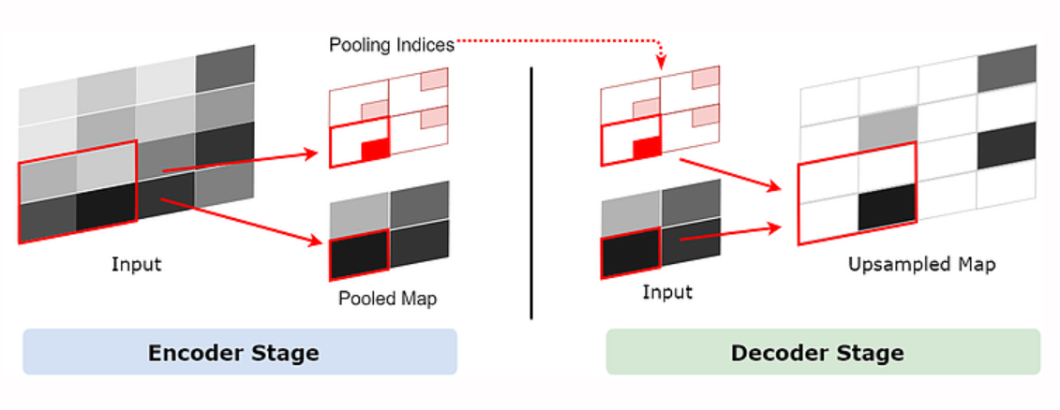
Using pooling indices for upsampling
Source: https://www.cyberailab.com/home/segnet-an-image-segmentation-neural-network

Slide 16
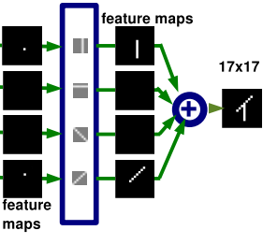
Decoder Filter Bank
Batch Normalization
Notes:
Is used to achieve translation invariance over small spatial shifts in the input image.

Slide 17
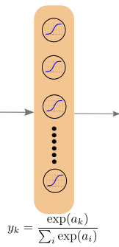
Softmax classifier
Notes:
Is used to achieve translation invariance over small spatial shifts in the input image.

Slide 18
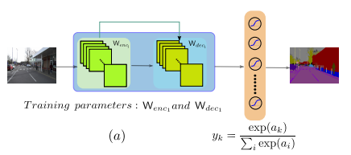
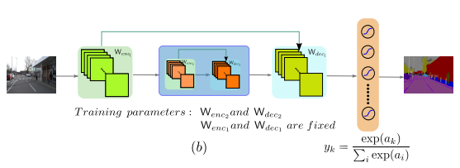
Training the SegNet
Notes:
(a) The modular training starts by optimizing the first encoder and decoder weights. The soft-max can be pre-trained or randomly initialized. (b) Once the first pair is trained, we insert an inner deeper encoder-decoder pair and optimize these weights while holding the outer encoder-decoder and soft-max weights fixed. More deeper pairs are then subsequently trained. Note encoder and decoder weights are untied.

Slide 19
Comparison of decoder variants
Variant | Params (M) | Storage multiplier | Inference time (ms)
Fixed upsampling
Bilinear-Interpolation | 0.625 | 0 | 24.2
Upsampling using max-pooling indices
SegNeg-Basic | 1.425 | 1 | 52.6
SegNeg-Basic-Encoder Addition | 1.425 | 64 | 53.0
SegNeg-Basic-SingleChannelDecoder | 0.625 | 1 | 33.1
Learning to upsample
FCN-Basic | 0.65 | 11 | 24.2
FCN-Basic-NoAddition | 0.65 | n/a | 23.8
FCN-Basic-NoDimReduction | 1.625 | 64 | 44.8
FCN-Basic-NoAddition-NoDimReduction | 1.625 | 0 | 43.9

Slide 20
Summary of different decoders analysis
The best performance is achieved when encoder feature maps are stored in full
Compressed forms of encoder feature maps can be stored and used for decoding to meet memory constraints
Larger decoders increase performance for a given encoder netrowork

Slide 21
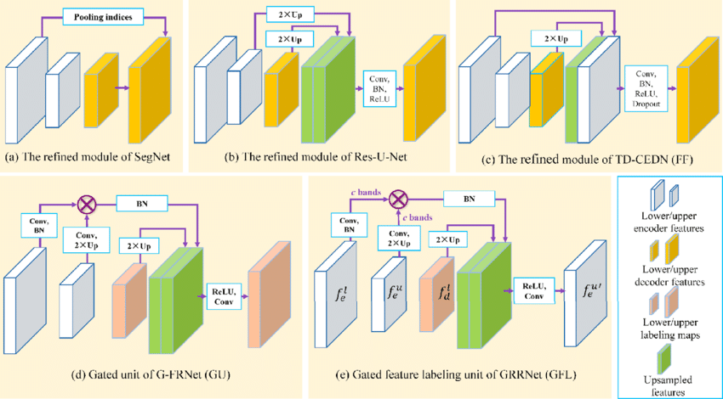
Schematic representation of different architectures

Slide 22
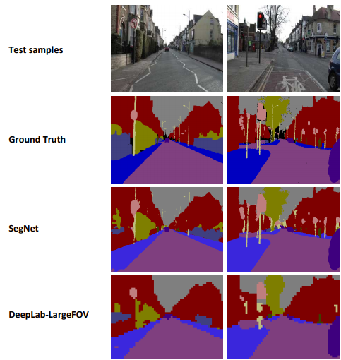
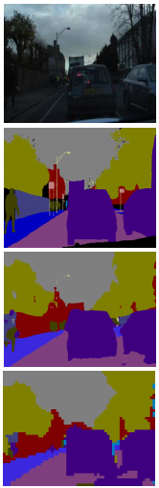
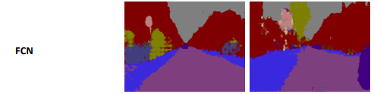
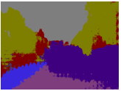
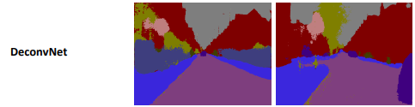
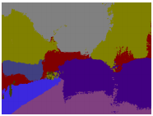
Road scene segmentation

Slide 23
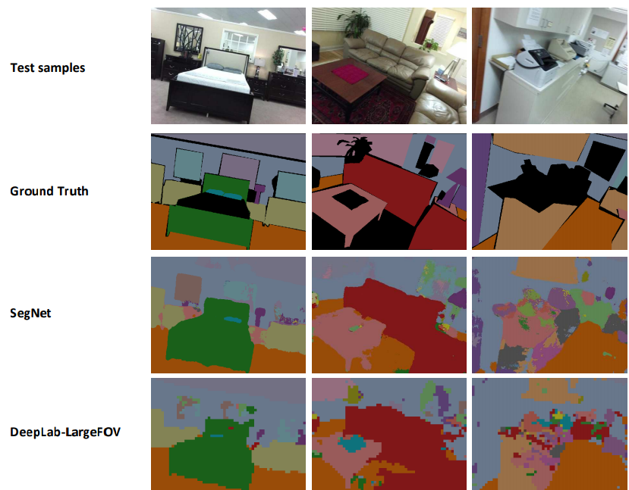
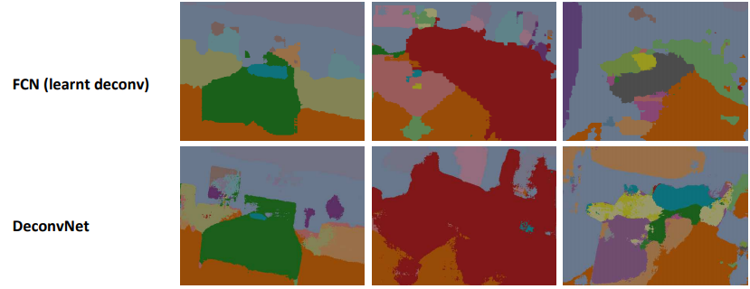
Indoor scene segmentation

Slide 24
Conclusion
SegNet is more efficient compared to other architectures since it only stores the max-pooling indices of the feature maps and uses them in its decoder network to achieve good performance
On large and well known datasets SegNet performs competitively, achieving high scores for road scene understanding
End-to-end learning of deep segmentation architectures is a harder challenge

Slide 25
References
http://mi.eng.cam.ac.uk/projects/segnet/
https://www.cyberailab.com/home/segnet-an-image-segmentation-neural-network
http://www.robots.ox.ac.uk/~tvg/publications/2017/CRFMeetCNN4SemanticSegmentation.pdf
https://neurohive.io/en/popular-networks/vgg16/

Slide 26
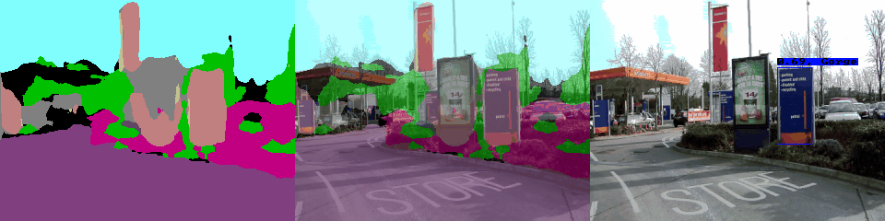
Questions?

